Slide 1
Data Transformation

Slide 2
Index Of Topics
For Skewed data
Left Skewed data
Cubed transformation
Squared transformation
Right Skewed data
Square root
Cube root
Logarithmic + 1
Reciprocal root
Reciprocal
Reciprocal Square
For Continuous data
Standardisation
Normalization
One hot encoding
Data Splitting

Slide 3
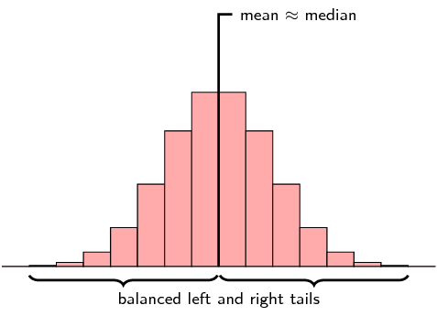
1. Transformation techniques for skewed data
What is skewed data and how to identify it?
Some distributions of data, such as the bell curve are symmetric. This means that the right and the left of the distribution are perfect mirror images of one another. Not every distribution of data is symmetric. Sets of data that are not symmetric are said to be asymmetric. The measure of how asymmetric a distribution can be is called skewness.
The mean, median and mode are all measures of the center of a set of data. The skewness of the data can be determined by how these quantities are related to one another.
Example of data that is perfectly symmetric and non-skewed

Slide 4
1. Transformation techniques for skewed data
To transform skewed data to symmetrical data, we are going to use the following packages and methods:
Packages:
numpy
pandas
matplotlib
seaborn
Methods:
pandas.read_csv
pandas.DataFrame.head
pandas.DataFrame.mean
pandas.DataFrame.median
pandas.DataFrame.mode
seaborn.kdeplot
matplotlib.pyplot.axes.axvline
matplotlib.pyplot.axes.set_title
matplotlib.pyplot.legend
matplotlib.pyplot.subplots

Slide 5
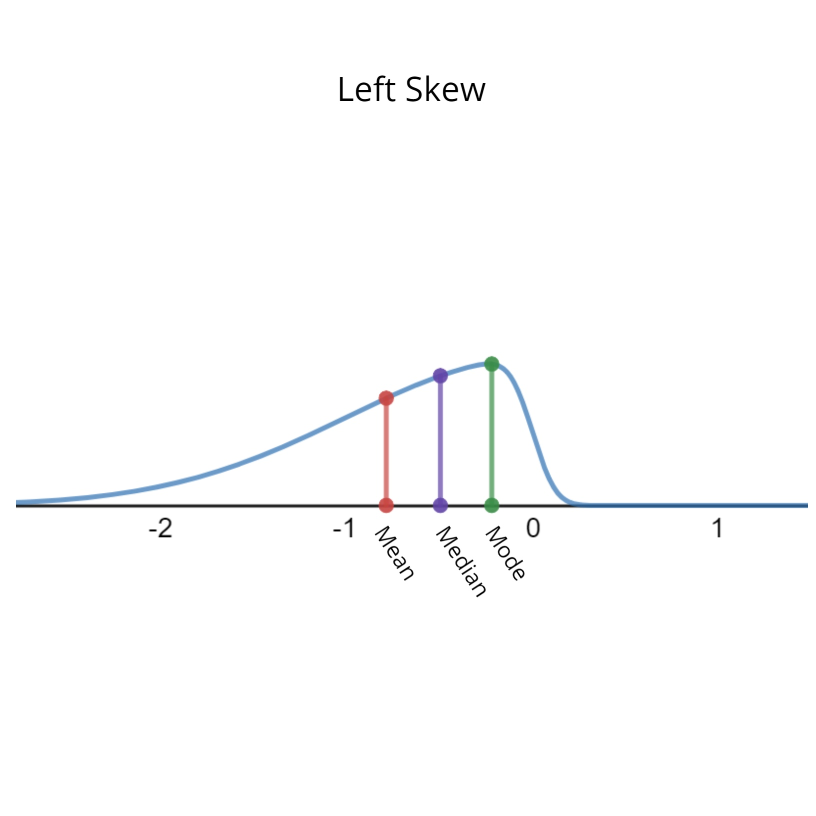
1.1 Left skewed data
Data that are skewed to the left have a long tail that extends to the left.
In summary, for a data set skewed to the left:
Always: mean less than the mode
Always: median less than the mode
Most of the time: mean less than median

Slide 7
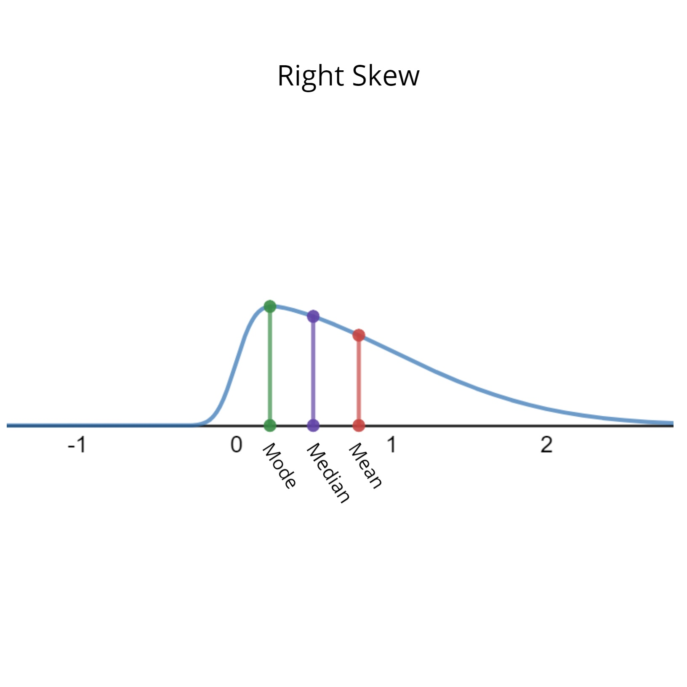
1.2 Right skewed data
Data that are skewed to the right have a long tail that extends to the right.
In summary, for a data set skewed to the right:
Always: mean greater than the mode
Always: median greater than the mode
Most of the time: mean greater than median

